Slide 1
D14 – BR:
Were the Spaniards right? Were the Native Americans “savages” that “needed” the Spaniards help? What do you think?

Slide 2
Utah Studies
Mountain Men in Utah
Goals for Today:
We will learn:
How the Old Spanish Trail affected Utah
What brought trappers and Mountain Men to Utah
About a specific Mountain Man of your choosing

Slide 3
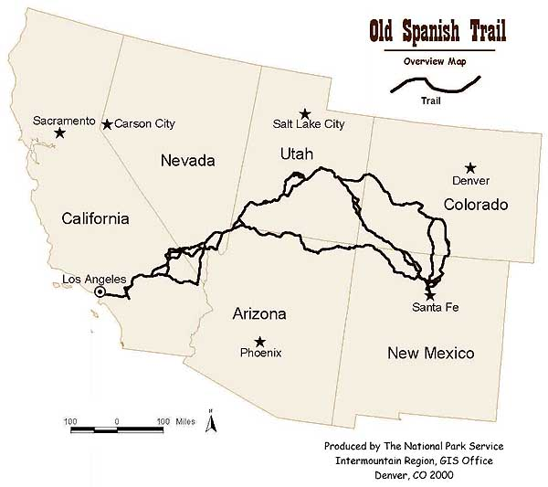
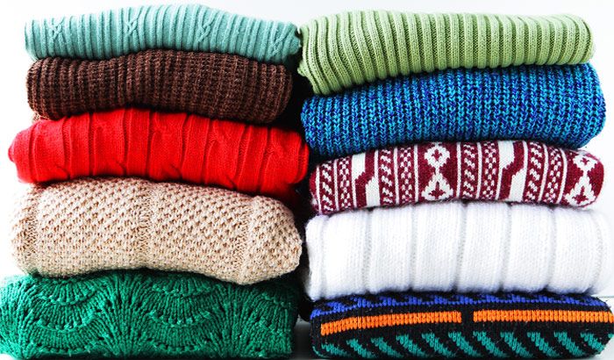
The Old Spanish Trail
As has been mentioned, the Old Spanish Trail cut through Utah on its way from Santa Fe to the Spanish Missions of California. Arizona had some dangerous Native American tribes, and so the Spanish Trail avoided contact with those tribes.
Thus the Old Spanish Trail was born. Supplies shipped from elsewhere landed in Los Angeles, and they made their way to Santa Fe via the trail. The most common commodity was woolen goods, made from the wool of sheep in New Mexico.
These were traded for horses and mules that were plentiful in California. Ships at the ports brought supplies, and took those woolen goods to the rest of the world. Spanish Trail Today: VID

Slide 4
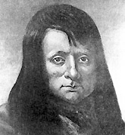
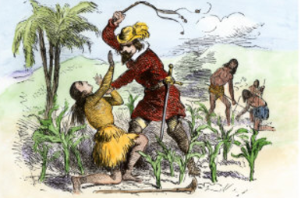
Dark Side of the Force…er, Trail
Sadly, the trail was also infamous for being used as a route for moving Indian slaves. Chief Walkara, a powerful Ute Leader, was heavily involved in this slave trade.
These slaves were used to work in mines, as servants, etc., far away, and the Spanish Trail provided a way to move them. However, the Mormons would eventually put an end to this as they saw it as wrong. TPS: is it ok to make such judgement?

Slide 5
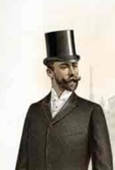
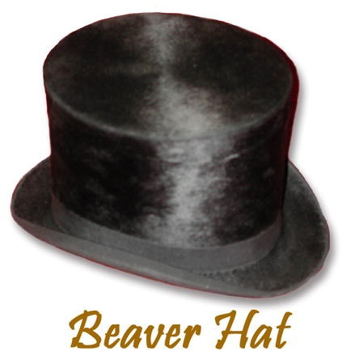
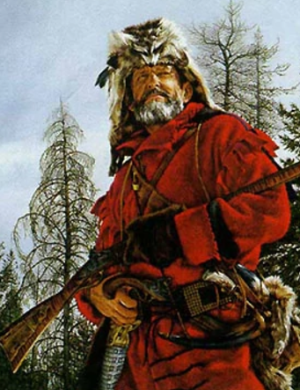
Mountain Men in North America
Fur trappers had existed since the 1600s in the East, with the French starting the trend. When French explorers first arrived in what is now Canada, they didn’t find the gold and riches that Cortez or Pizarro found, but they did find something almost as good: furs.
Animal pelts / furs, from beavers, foxes, and other animals, were highly valuable back in Europe, and became quite the trendy item for nearly 200 years. Even into the 1800s, they sold for a lot of money. The British and French trapped heavily for lots of profit.
These trappers started in the East, trapping animals and furs, while maintaining friendly relations with the Indians, living like them, sometimes even marrying them. Gradually they moved West, eventually reaching the Rockies, and here they became known as Mountain Men. VID

Slide 6
Classwork: Mountain Man Poster
See the assignment; we’ll continue talking about the Mountain Men next time, but you’ll be doing some research into your chosen Mountain Man first.

Slide 7
BR D15:
Did the mountain men get along with the Native Americans?
Also, share some details about your chosen Mountain Man:

Slide 8
Utah Studies
Mountain Men in Utah, Part II
Goals for Today:
We will learn:
About a specific Mountain Man of your choosing
About several Mountain Men that came to Utah
The importance of rendezvous
What brought about the end of the Mtn. Man era
What happened to the Mtn. Men afterwards.

Slide 9
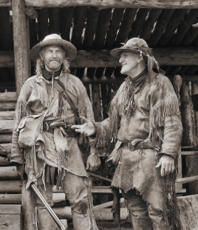
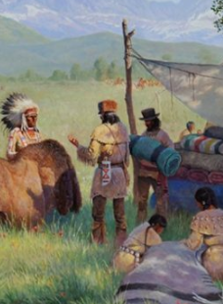
Rendezvous!
The rendezvous was a meeting of the trappers, which was a get together of trappers once a year with representatives of the fur-trading companies. Trappers would find their caches, or hidden batches of furs that they had buried for safekeeping, and gather them all together, then head to the rendezvous.
There, they’d sell or barter / trade their furs for supplies. The first day was usually just a big party though, since many of them hadn’t seen each other for a year. Then they’d get down to business, trading and swapping furs for knives, gunpowder, lead for bullets, flour, etc.
Cache Valley Utah, in Northern Utah, had some rendezvous, and is named for the mountain men caches of furs we mentioned. There is an annual Rendezvous all over Utah and the whole country! VID

Slide 10
Jigsaw Activity
Next, you’ll learn a little bit more about some of these Mountain Men and others from the era.
Each person at a table will get a person to learn about: as you read quietly, fill out the worksheet, and read it quietly (7 min)
Then, (on my signal), get together with others who read the same thing. Discuss what you read, and answer the questions together. (3 min)
Then (on my signal), go back to your table, and take turns talking about the character you studied. Answer the group questions based on your discussion (7 min)
Join a classroom discussion (5 min) Finish worksheet.

Slide 11
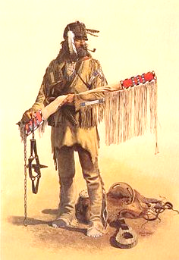
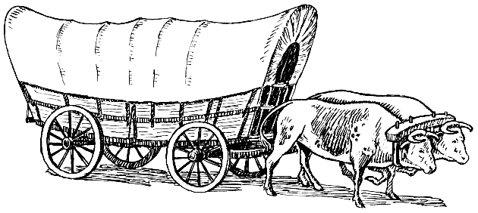
End of an Era
The Mountain Men were able to trap and live this lifestyle for about 20 years in Utah, though in the U.S. and Canada it had occurred for over 100 years. By the mid 1840s, many of the beavers were gone, and fashion styles changed so that people wanted fancy silk hats instead of beaver hats.
Many of the mountain men then went into business as trail guides for settlers coming to California, Oregon, and Utah, as well as working for the U.S. government as explorers and map makers. They would also be joined by other official government explorers, which we’ll talk about later.
The lives of the Native Americans were forever changed as a result of these interactions. The Utes for example now had guns, horses, and metal objects. However, the arrival of the Mormons would shift that balance of power yet again.

Slide 12
HW Reminder:
Rest of class is working on Mountain Man Project!
Ch. 4 Test will be D16
Finish your Jigsaw worksheets if you haven’t already!

