Slide 1
D15 – Bellringer
Define Kairos; what does it mean? (review pp. 49-53)
Describe a situation where the Kairos (the opportune time; see this vid for a review of the word) might be best for someone wanting to:
A: Promote Gun Control (Example: Florida Shooting)
This is a story about the Stoneman Douglas High School Shooting in Florida…people were upset, angry, etc., and that proved to be an ideal time for those in favor of stronger gun control to put the blame (justified or not) on poor / lax gun control laws.
B: Promote Gun Rights (Example: Springville Attack)
Conversely, here’s a story about a person with a Concealed Carry permit, who came to the aid of a police officer, and stopped his assault. Had he not been carrying a weapon, things may have turned out differently. Here a pro-gun advocate could argue that here, the 2nd Amendment rights being used by this person may very well have saved the police officer’s life.

Slide 2
Ch. 4, Part II Kairos & Decorum
P. 54: What is discourse?
P. 54-55: How is college, for example, an example of many diverse communities? Explain:
P. 55: “Every community has a s_________.” Explain:
P. 56, par. 2: “Persuasive power can come from _____________________________________.”
P. 56: What’s a “gatekeeper”? Explain:
Kairos is about talking to the right p____, at the right t____, in the right p____, under the right c________.
P. 54: The “Life Cycle” of an issue has four main parts; define each, explain when the “critical / opportune moment” aka Kairos is:
Pp. 60-61: What is “decorum”? Explain, and give some good / bad examples:
Does defying decorum work? Explain:
Notes:
Kairos is about talking to the right p____ (people), at the right t____ (time), in the right p____ (place), under the right c________ (circumstances).

Slide 3
Note:
Mr. Wright will be checking with local stores to help create a shirt for our debate team. We have $300 total!

Slide 4
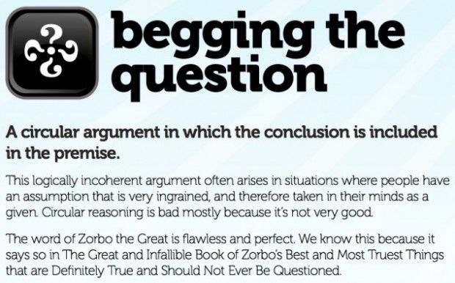
Logical Fallacy 2: Begging the Question
This is a form of circular reasoning, where you just double back on your claim. VID

