Slide 1
D15 – Bellringer
Guess how much money we raised:
$300+!!!!
Good work!

Slide 2
Ch. 4 Analyzing an Argument
P. 50: What is the Rhetorical Situation? What does it look like?
P 50-51: “Determining ___ _______ ________ is key to understanding your role…and I________ ____ ________ in the r_______ s_______ is eseential to arguing effectively.
P. 51: “You could define the art of rhetoric as the art of:______
P. 51: What is the first Greek definition of time? Define it:
P. 51-52: What is the second def. of time? Explain:
P. 53: What is community? Why does it matter?

Slide 3
Final 5: Logical Fallacy of the Day:
Ad Hominem – Personal Attack
These are very common…
Basically, you argue that someone is dumb / bad / whatever, and that should mean whatever argument they have made is invalid.
It is a distraction from the argument, and doesn’t address it.

Slide 4
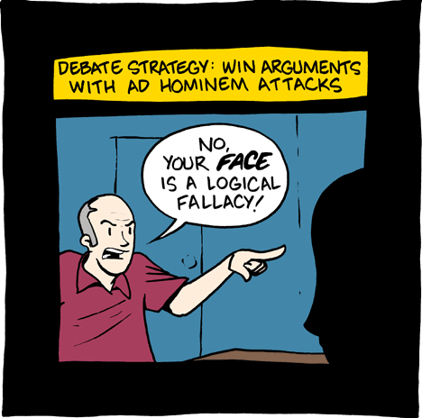

Slide 5
