Slide 1
D2 – Bellringer!
Think about your game idea; analyze it using the colored hats:
Logic
Optimism
Devil’s Advocate
Emotion
Creativity

Slide 2
Introduction:
We need another volunteer:
You’ll again be describing a game, and the rest of us will offer suggestions, ideas, etc.

Slide 3
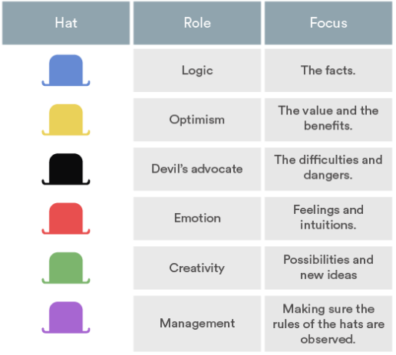

Slide 4
Go and Do!
Now, go and play another game, and as you do, consider the 5 hats for it and your own game…

