Slide 1
Bellringer: D2
What is Location? What are some ways we measure location? Why is location important?

Slide 2
Utah Studies
Day 2: Ch. 1: Geography & Location

Slide 3
Main Ideas:
Location
Latitude
Longitude
Geography
Natural Resources
Renewable vs. Non-renewable

Slide 4
Geography
What is Geography?
It is the study of the earth and its mountains, lakes, plateaus, valleys, deserts, oceans, rivers, etc.
These are all different types of landforms.

Slide 5
Mountains: Mt. Timpanogos

Slide 6
Mt. Nebo

Slide 7
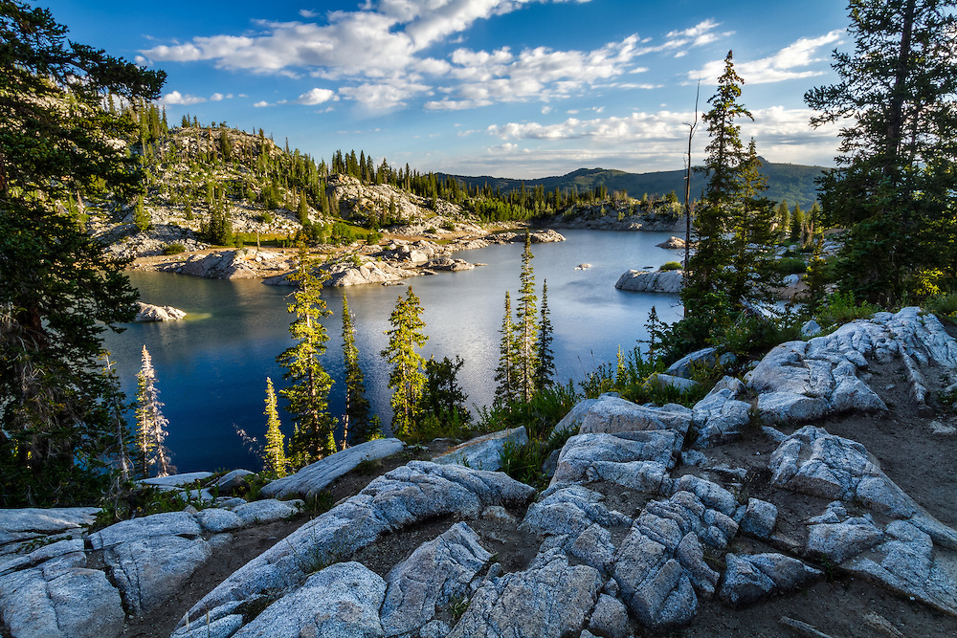
Lakes: Lake Mary

Slide 8
Lake Powell

Slide 9
Green River

Slide 10
Salt Flats
VID

Slide 11
Favorite?
What is your favorite place in Utah? Why?

Slide 12
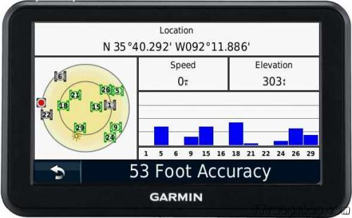
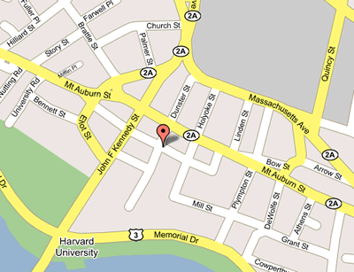
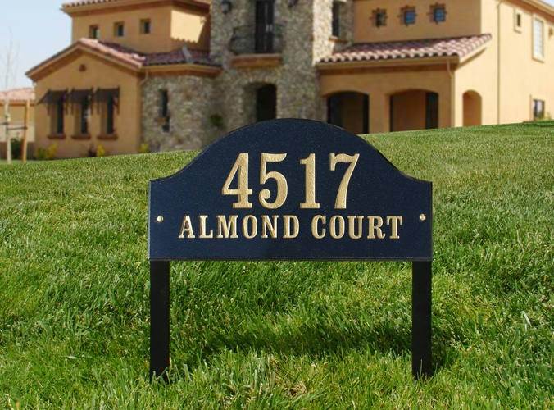
Location! Location! Location!
So what is location?
Is it an address?
A GPS Coordinate?
A Spot on the Map?
…Yes!
It’s all of these!

Slide 13
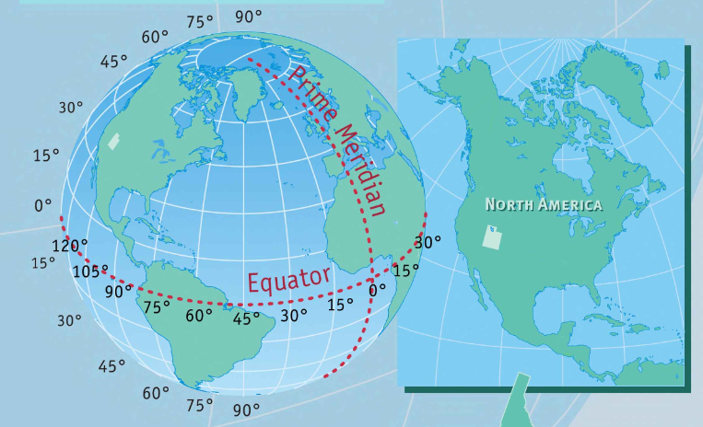
So Where is Utah?

Slide 14
Longitude vs. Latitude
Latitude measures how far north or south we are from the equator.
Longitude measures how far east or west we are from the Prime Meridian.
For example, Salt Lake City is about 41 Degrees North latitude, 112 Degrees West longitude.
Check it out!
https://goo.gl/L4m4fy
Geocache Activity

Slide 15
Physical Features
Another name for landforms is physical features. We can see physical features all around us; the mountains, creeks, etc.
Another important thing that we get from these things are called natural resources.
Natural resources are things that we can use, like plants, animals, minerals, water and fresh air, etc.
Without natural resources, we couldn’t live here.
Think Pair Share: What are 3 natural resources that we use here in Utah today? What are they used for?

Slide 16
Examples: Glen Canyon Dam

Slide 17
Kennecott Copper Mine

Slide 18
Renewable vs. Non-Renewable
We certainly have many natural resources here in Utah. Some are renewable , which means they are easily replaced and come back.
Can you think of any examples of renewable resources?
Other resources don’t easily come back. They will be gone for a very long time, or forever. These are known as non-renewable resources.
Can you think of any such resources?

Slide 19
Homework:
Complete 1 of the following activities:
Natural Resources Worksheet and Reflection
Geocache Location Activity
Both of these will be found on the class website

