Slide 1
D4 – Bellringer
Grab your textbooks, and take a look at pages 103-107:
Proceed to answer the following questions:
Summarize figurative language in a sentence:
Summarize one of the uses of figurative language that the author shares (pp 104-105)
Pick three of the terms described on pp 106-107, and give an original example of each:

Slide 2
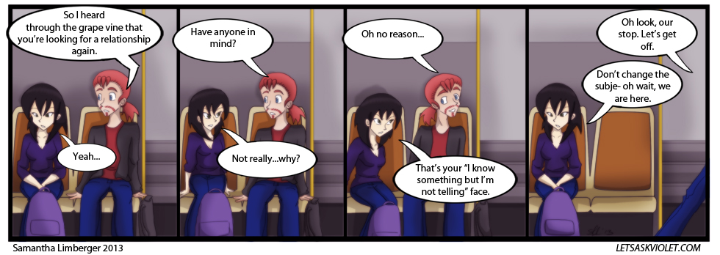
Logical Fallacy of the Day
Avoiding the Issue
Avoiding what the other person has said, through a distraction, unrelated comment, etc. (happens a LOT)

Slide 3
Research Time
Get to work researching the next topic (remember to record citations via APA style)
Resolved: The United States federal government should substantially reduce its restrictions on legal immigration to the United States in one or more of the following areas: refugees, childhood arrivals, student visas, H-1B visas, etc.

