Slide 1
BR: D4
Which settlement did you choose for your Mini-PBL? Share 2-3 facts about it! (note: we will have a Binder Check)

Slide 2
Utah Studies
Settling the Great Basin
Ch. 7.4 Statehood for Utah?
Today we will:
Why statehood was worth attaining
Discuss the factors that kept Utah from becoming a state

Slide 3
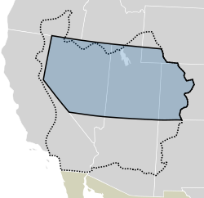
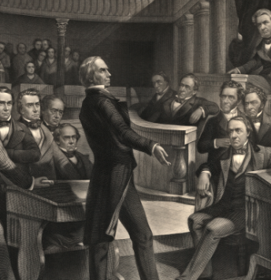
The State of Deseret
After being in Utah for only several years, the Mormons began to dream of their own state. They decided to call it Deseret, an ancient word from the Book of Mormon that meant “honeybee”, as a symbol of industry / work.
The first petition was turned down. Issues of slavery divided the nation, and if Deseret was admitted, would it be a slave or free state? Henry Clay helped Utah towards statehood: VID
Being caught up in these bigger, national issues, Utah was mostly ignored, though it now had some more rights as a territory. It was named Utah because of the Ute Indians, and the Congress didn’t like the name Deseret, because it was weird, Mormon, and sounded too much like “desert”.
Dotted line was the original State of Deseret Proposal; Blue was the Territory of Utah, created in 1850

Slide 4
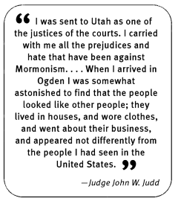
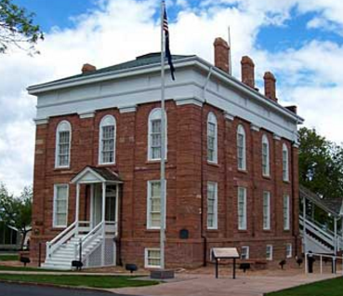
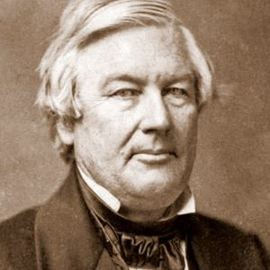
Utah Territory: Better…?
Being a territory had some pros. It allowed Utahns to elect some of their own leaders, and local laws. However, they had no say in the presidential election, and no say in Congress, though they did have representatives, but with no voting power.
Mostly, Utah was run by the Federal Government, and this irked most Mormons, who fiercely defended their individual rights. At first, Brigham Young was appointed governor, and three federal judges were called and sent to Utah from the East. These other appointments were outsiders who the Mormons didn’t know or trust.
Meanwhile, Fillmore Utah was chosen, as it was in the middle of the new territory, (named after the U.S. Pres. Millard Fillmore at the time), to became the territorial capital in 1851.

Slide 5
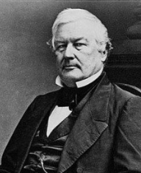
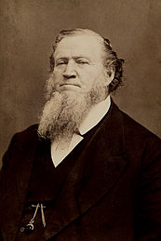
Continuing in the Territory
Wait…where’s Utah?
Fillmore as the territory statehouse didn’t last long. The territory legislature only met there once, as it was quite far away for most people (most of the influential people in Utah lived in SLC at the time).
Also, it was a vain attempt to get Pres. Fillmore to make Utah a state, by aiming at his pride. He didn’t give much of a hoot about Utah, and his namesake city, and Fillmore didn’t last long as capital, with SLC being the de facto capital anyway. Fillmore lasted 5 years as capital of Utah.
Meanwhile, as governor, Brigham Young continued to be “the Great Colonizer”, working to create over 300 settlements throughout the Western United States, Mexico and Canada. He was replaced as governor in 1857, but served as President and Prophet until his death in 1877.
Check out the Handcart Handout for the remaining questions:

Slide 6
Feedback Attack!
Instructions:
Ok! So, now you are going to individually (NOT as a group) go and find other people you aren’t working with, and you will take your Feedback Attack Worksheet with you. Grab a clipboard to do this, or do so at a table.
30 s - 1st: Find a listener (someone who isn’t working with you already, if possible); swap your Feedback Attack Sheets with each other
2 Min - 2nd: Show your presentation to them, and explain it. Your “listener” will be taking notes on your sheet as this time, in order to give you feedback.
2 Min - 3rd: Now, the “Listener” and the “Speaker” swap roles. Spend another two minutes, speaker, and share your presentation.
1 Min - 4th: Give each other feedback (Hearts = things you liked; & Wishes = Things that could be improved)
Start over, with a new partner! (do this twice)!

Slide 7
Reminder:
We will now finish getting ready to present our Mormon Settlement Presentations. You’ll have another 30 minutes to finish those next class, but the final will be presented next time / D9! Use the remainder of class to get that done!
Also, don’t forget to study your notes for the test; we’ll review and take the test on Ch. 7 next time!
Next Class Schedule:
~20 minutes: Ch. 7 Review / Quiz
~30 minutes: Mormon Settlement Work
Last ~30 minutes: Present Mormon Settlement Presentation!

