Slide 1
D5
Review your Value of Rights and Life without Rights for the Accused HW Reading; describe 2 times his rights were violated:
What do you think the term “Living Constitution” means? Is our constitution a living document, or is it dead? Justify your answer:
I would argue that it is in fact a living document, in the sense that it can be changed and adapted. What way do we change it?

Slide 2
U.S. History I
Ch. 7.5C - A Living Constitution, & The Federal Government
Argue that the U.S. Constitution is alive;
Discuss the work of the Legislative Branch
Create our very own bill!

Slide 3
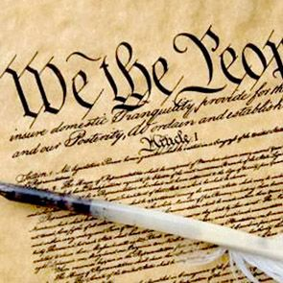
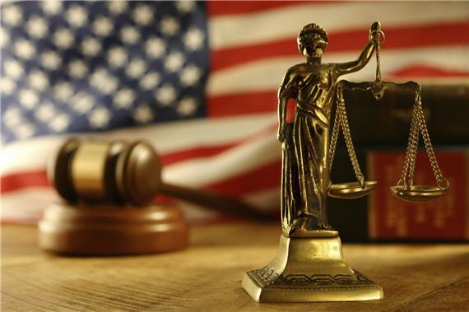
Changing the Constitution
Our Constitution has lasted so long in large part because it is adaptable. Thru the Amendment Process, it can be changed to deal with unforeseen challenges, like regulating nuclear power plants, something the Framers couldn’t have imagined.
Also, it can be interpreted in different ways, making amendments sometimes unnecessary. For example, Judicial Review, the process by which the Supreme Court can decide the constitutionality of a law / executive order / policy, etc., allows for changes to occur as well.

Slide 4
The Federal Government
First, let’s look at the Legislative Branch:

Slide 5
The Legislative Branch
Our Congress is made up of two houses: the Senate (100 voting members, 2 from each state) and the House of Representatives (435 voting members, with a nonvoting representative for the District of Columbia, Puerto Rico, Guam, American Samoa, and the Virgin Islands).
Representatives must be at least 25 years old, and they serve 2 year terms. Senators must be 30 years old, and serve six year terms.
The main roles or jobs of Congress are to make the nation’s laws, and to control government spending. SchoolHouse VID
There are also many different committees that exist to discuss specific issues that may involve them. VID

Slide 6
Class Activity: See the handout, and check out my website to see the full details:
Get in a group of no more than four students (5 min), with at least one student each given the following assignments (all are expected to help research, stay busy, etc. no matter their assignment; help others in their roles as needed):
Scribe: Will write down notes etc., and ultimately the bill in its final form
Committee Chair: This person will vote on which bills go to Congress, leader of the group.
Vice Chair: Write down outline of bill ideas, questions for group, etc.
Brainstorm / research on problems in your school, community, state, or nation that you would like to see resolved. (15 min)
Write-up a bill that will solve the problem that your group has identified (see the example bill for ideas on what that should look like). (10 min)

Slide 7
Present your bill to the committee (one person per group). (15 min for all bills)
Answer questions from students regarding your bill. (5 min)
The committee will decide if the whole Congress should see the bill or not. Then (if it passes), the class / Congress will vote on your bill (a simple majority will send it on to the president (teacher). Failure to get a simple majority will kill your bill. (5 min)
If the class approves your bill then the president (teacher) can either approve or reject (veto) your bill. (5 min)
If the president approves the bill it becomes law, if it is vetoed you will have another opportunity to argue your case to the class. (1 min)
The class will once again vote on your bill, if 2/3rds of the class votes for your bill it will override the president’s veto and become law. (10 min)
Once your bill has been made into law or killed turn in your hand written version of the bill. (1 min)

